Slide 1
Department of Census and Statistics – Sri Lanka
International Seminar on Modernizing Official Statistics:
Meeting Productivity and New Data Challenges
A PRESENTATION
ON MODIFICATION OF DATA DISSEMINATION
Tianjin, People’s Republic of China: 24th – 26th October 2013

Slide 2
Law on Statistics
Department of Census and Statistics
Census Ordinance and Statistical Ordinance provide Legal authority for fixing administrative responsibilities on public officers, placing legal obligation upon the public to give correct answers and for maintaining confidentiality of the individual information, in Censuses/Surveys .

Slide 3
Organizational Structure
Department of Census and Statistics – Sri Lanka
12 Technical Divisions Headed by an Additional Director General /Director/Deputy Director
Branch Offices in each of the 25 District offices headed by a Deputy Director or a Statistician
A Statistical Officer attached to each of the 9 Provincial Councils
Units in Key Ministries and Departments

Slide 4
Censuses and Surveys conducted by DCS
Department of Census and Statistics – Sri Lanka
Population and Housing Census
Census of Industries
Economic Census
Labour force Survey
Demographic and Health Survey
Household Income and Expenditure Survey
Household Computer Literacy Survey
Computer Literacy Survey of school children and teachers
Child Activity Survey

Slide 5
Economic Statistics compiled by DCS:
Department of Census and Statistics – Sri Lanka
Consumer Price Index (CPI)
Producer Price Index
Wholesale Price Indexes
National Accounts

Slide 6
Livestock & Agricultural Statistics
Department of Census and Statistics – Sri Lanka
Agricultural Census (Now a part of the Economic Census)
Crops Production Survey (eg Paddy)
Livestock Statistics (A reporting System)
Environmental Statistics

Slide 7
National Data Committee (NDC)
Department of Census and Statistics – Sri Lanka
Objectives
Review National Statistical System (NSS)
Promoting interactions with data users
Consider statistics produced by all players of the NSS organizations
Recommend improvements to DCS programmes
An MOU is to be signed for exchanging TAX data on the recommendation of NDC

Slide 8
DATA DISSEMINATION
Department of Census and Statistics – Sri Lanka
PRINCIPALS FOR DATA DISSEMINATION:
Equal access to the results of statistical surveys and other activities
Users’ equality
Transparency

Slide 9
MAIN PRIORITIES IN THE FIELD OF DISSEMINATION
Department of Census and Statistics – Sri Lanka
Diversification and improvement of the information products and services provided;
Up-to-date statistical information;
Fully usage of the contemporary electronic methods for data dissemination;
User-friendly data support;
Enlargement of the circle of local and foreign users

Slide 10
Data Dissemination
Department of Census and Statistics – Sri Lanka
Processed Data: Indicators, Statistics
Micro Data

Slide 11
Dissemination of processed data
Department of Census and Statistics – Sri Lanka
1- Traditional:
Publications and Reports (Hardcopy )
Press conferences and Press Releases
Library and Personal visits
2- Electronic:
Internet: DCS website
E- mail
CD- Rom
3- Thematic maps: spatial variation

Slide 12
New Data Dissemination methods
Department of Census and Statistics – Sri Lanka
Dynamic website
Web based meta database
Web based interactive mapping
New indices
Thematic mapping/Use of GIS for disseminating statistical data
Advance data release calendar
Micro Data Dissemination Policy

Slide 13
Means of Dissemination
Department of Census and Statistics – Sri Lanka
Publications:
The main priorities in the field of publishing and data disseminating activities are to increase the variety and improve the quality of issued statistical publications and to transform them into user-friendly products
Library:
The library has a unique fund of statistical and economic publications of national and international statistics.
Dissemination of processed data

Slide 14
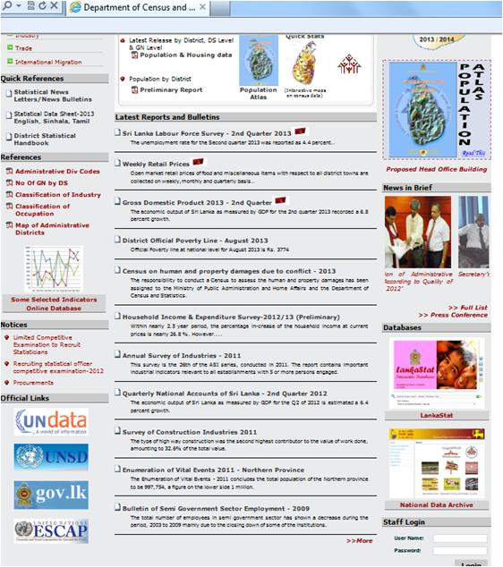
Home page of DCS website
Department of Census and Statistics – Sri Lanka
Website contains:
Legislative basis for the institute’s activity
Methodological notes on main statistical surveys and their results
Information on publications deposited in the library
Advance data release calendar
Press releases
Analytical materials and
information on different subjects etc.
Dissemination of processed data

Slide 15
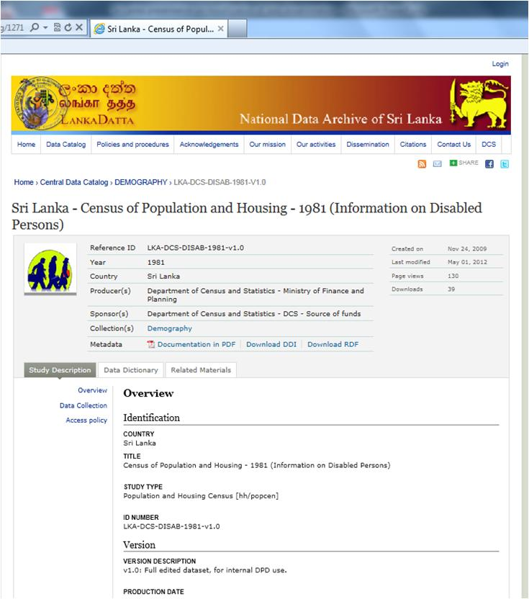
Department of Census and Statistics – Sri Lanka
National Data Archive of Sri Lanka: A meta database published in the DCS website
Dissemination of processed data

Slide 16
A web based interactive mapping system to disseminate census data
Department of Census and Statistics – Sri Lanka
Dissemination of census data
Dissemination of processed data

Slide 17
Department of Census and Statistics – Sri Lanka
Dissemination of census data through composite indices
eg: Indicators used to introduce ‘Housing Quality Index’
Access to Safe Drinking Water
Exclusive Toilet Facilities
Electricity for Lighting
Permanent materials used for Walls
Permanent materials used for Roofs
Dissemination of processed data

Slide 18
Department of Census and Statistics – Sri Lanka
Method used to compile ‘Housing Quality Index’
Principal Component Analysis (A variable reduction method) using SPSS software package
Computation of Composite Indicator (Housing Quality Index (HQI)) on quality of housing, capable of explaining variation in quality of housing, statistically at GN, DS and District level
Mapping the HQI for easy visualization
Dissemination of processed data

Slide 19
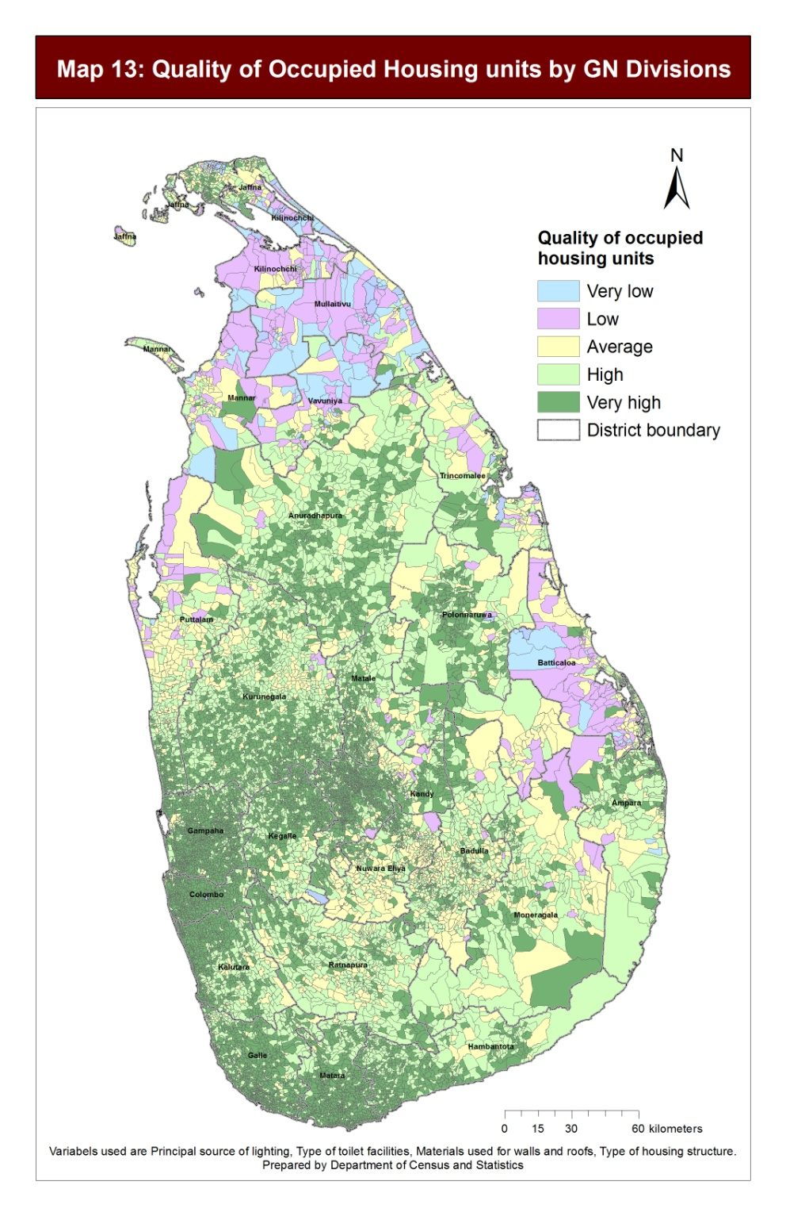
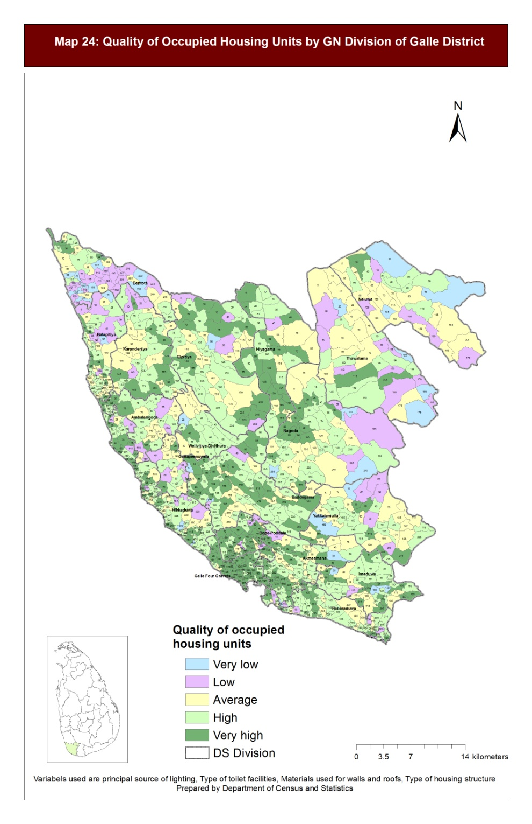
Department of Census and Statistics – Sri Lanka
Thematic maps: Maps on ‘Housing Quality Index’
Dissemination of processed data

Slide 20
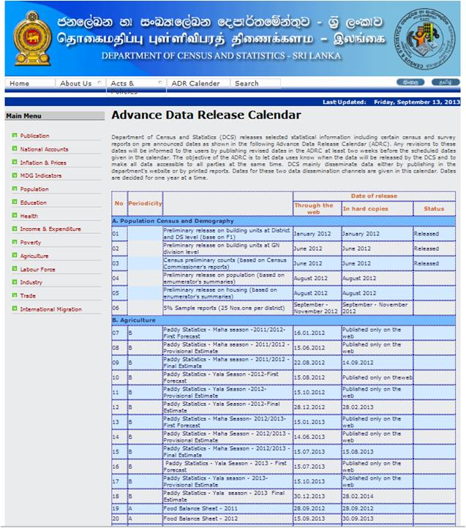
Department of Census and Statistics – Sri Lanka
Advance Data Release calendar keeps users informed data dissemination periods
Dissemination of processed data

Slide 21
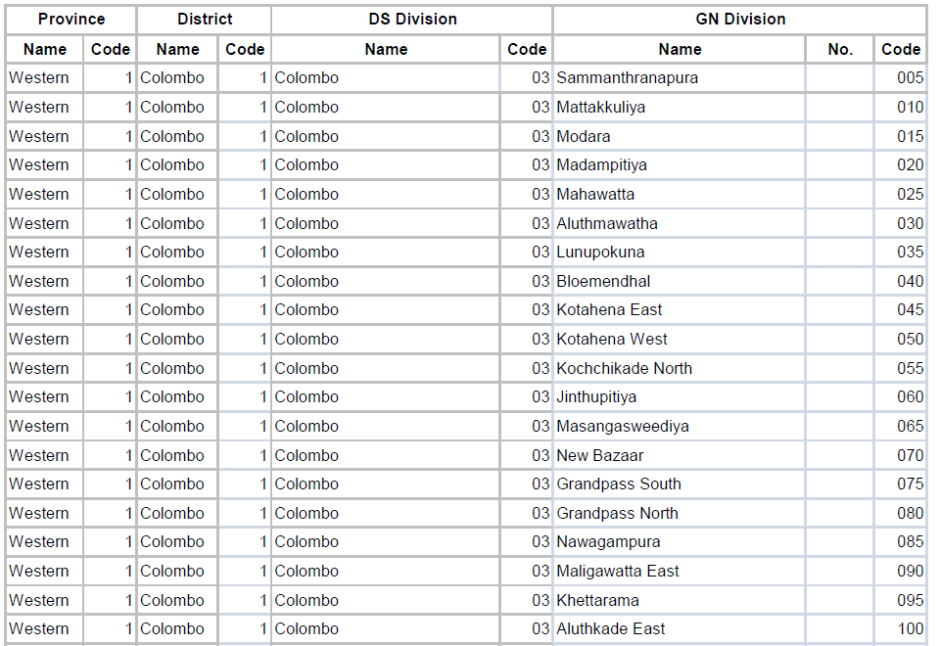
Department of Census and Statistics – Sri Lanka
Administrative codes are published in the DCS website
Dissemination of processed data

Slide 22
Department of Census and Statistics – Sri Lanka
Dissemination of Micro data
Dissemination Policy on Micro data
Department of Census and Statistics (DCS)
Sri Lanka
This policy on microdata dissemination has been formulated with the objective of defining the nature of the anonymised microdata files that will be released, the intended use of these files and the conditions under which these files will be released.

Slide 23
Department of Census and Statistics – Sri Lanka
Dissemination of Micro data
Dissemination Channel
Metadata for DCS studies are provided to public through the DCS NADAhttp://statistics.sltidc.lk/index.php/home.
Access to PUFs and licensed microdata files is granted to users provided they adhere to the conditions prescribed
Data requesters are asked to state the purpose of their request through the online application form.
Requests will be evaluated within a period of one week.
NADA provides a facility where users can check the status of their requests.

Slide 24
Thank You

Slide 25
Department of Census and Statistics – Sri Lank
International Seminar on Modernizing Official Statistics:
Meeting Productivity and New Data Challenges
Thank You
Tianjin, People’s Republic of China: 24th – 26th October 2013

